Slide 1
I/O Operations
UNIT 4

Slide 2
Input-output (I/O) systems
Input-output (I/O) systems transfer information between computer main memory and the outside world.
An I/O system is composed of
I/O devices (peripherals),
I/O control units, and
software to carry out the I/O transaction(s) through a sequence of I/O operations.

Slide 3
I/O devices can be classified as
Serial, i.e. able to transfer bit streams one bit at a time, or
Parallel- Parallel devices have a wider data bus and can therefore transfer data in words of one or more bytes.

Slide 4
Like any other activity in a computer system, I/O is a intensive work of both hardware and software.
The software which is executed to carry out an I/O transaction for a specific I/O device is called a device driver.
An example of such an I/O transaction is reading a block of data from disk to memory.

Slide 5
The software to do this is simply a sequence of I/O operations (instructions) to transfer data between the peripheral devices and main memory, and to enable the central processing unit (CPU) to control the peripheral devices connected to it
Thus, I/O operations are of two classes:
control operations and
data transfer operations.

Slide 6
The main difference among I/O systems is the degree of CPU involvement in the transactions.
In a simple system, with a minimal I/O control unit, the CPU must perform all I/O operations like :
initiating the transaction,
checking device status,
transferring data between the devices and main memory, and
terminating the I/O transaction
In this case the system is said to be using programmed I/O

Slide 7
I/O addressing methods
In order for the CPU to communicate with I/0 devices in the system, an addressing scheme is needed. Two I/O addressing methods are used:
Memory-mapped
I/O –mapped

Slide 8
Memory-mapped
As a CPU needs to communicate with the various memory and input-output devices (I/O) as we know data between the processor and these devices flow with the help of the system bus.
There are three ways in which system bus can be allotted to them :

Slide 9
Separate set of address, control and data bus to I/O and memory.
Have common bus (data and address) for I/O and memory but separate control lines.
Have common bus (data, address, and control) for I/O and memory.

Slide 10
I/O-mapped
IO mapped IO uses two separate address spaces for memory and IO device.
There are two separate control lines for both memory and IO transfer.
In other words, there are different read-write instruction for both IO and memory.
IO read and IO write are for IO transfer whereas memory read and memory write are for memory transfer.
CPU uses these two methods to perform input/output operations between the CPU and peripheral devices in the computer

Slide 11
Mode of Transfer
The binary information that is received from an external device is usually stored in the memory unit.
The information that is transferred from the CPU to the external device is originated from the memory unit. CPU merely processes the information but the source and target is always the memory unit. Data transfer between CPU and the I/O devices may be done in different modes.

Slide 12
Data transfer to and from the peripherals may be done in any of the three possible ways
1. Programmed I/O.
2. Interrupt- initiated I/O.
3.Direct memory access( DMA).

Slide 13
1. Programmed I/O:
It is a method of data transmission, via input/output (I/O), between a central processing unit (CPU) and a peripheral device, such as a Parallel storage device

Slide 14
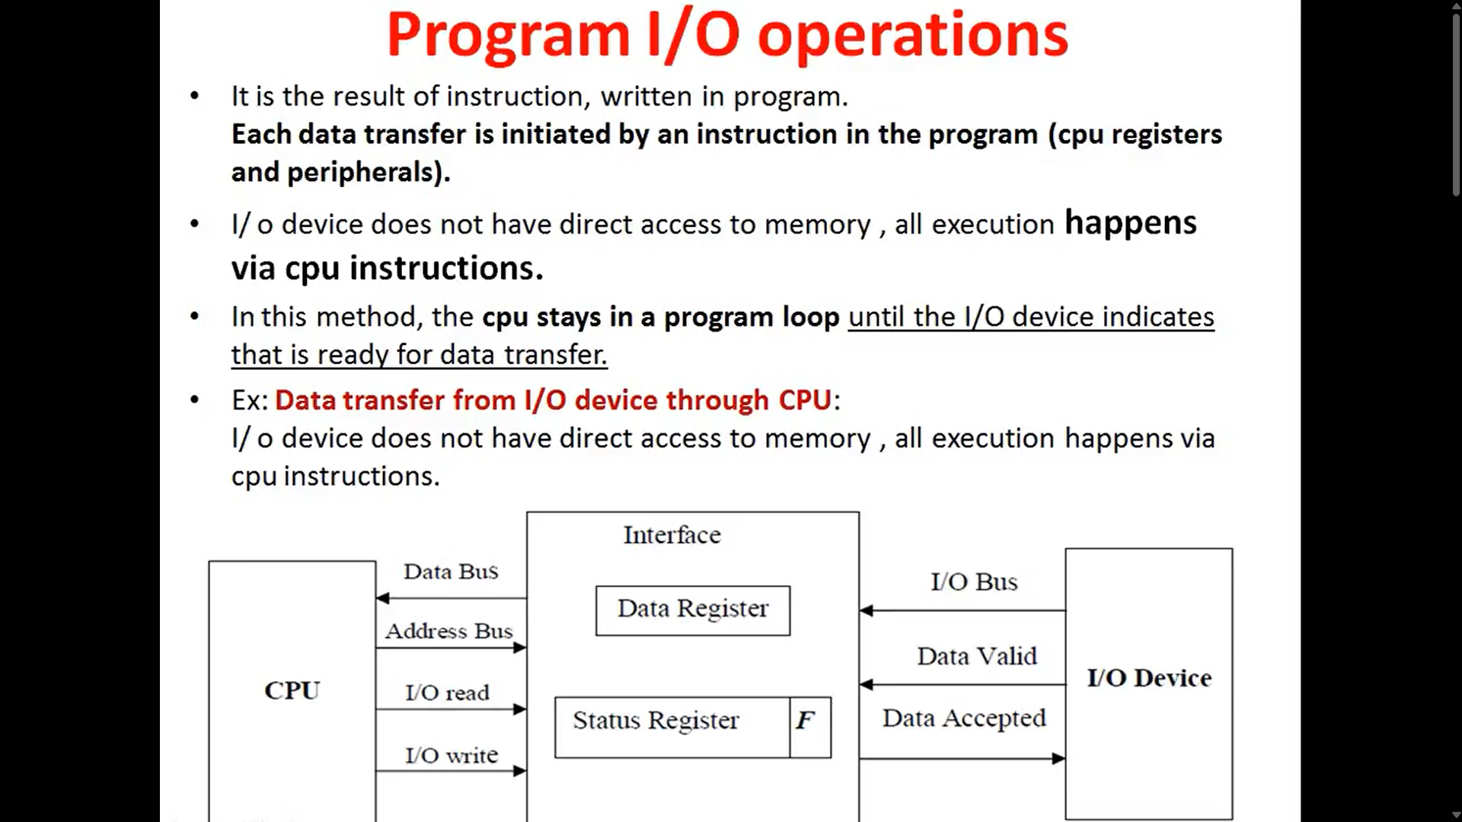

Slide 15
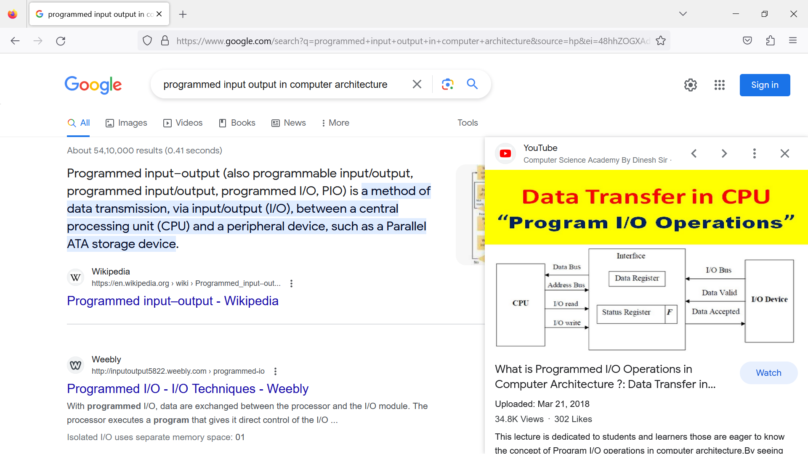
There are two kinds of FLAGS; Status FLAG and Control FLAG. Status FLAG reflect the result of an operation executed by the processor.

Slide 16
2. Interrupt- initiated I/O
In the above case we saw the CPU is kept busy unnecessarily. This situation can very well be avoided by using an interrupt driven method for data transfer.
By using interrupt facility and special commands to inform the interface to issue an interrupt request signal whenever data is available from any device.

Slide 17
In the meantime the CPU can proceed for any other program execution. The interface meanwhile keeps monitoring the device. Whenever it is determined that the device is ready for data transfer it initiates an interrupt request signal to the computer.

Slide 18
3. Direct Memory Access:
We can allow the peripherals directly communicate with each other using the memory buses, removing the intervention of the CPU. This type of data transfer technique is known as DMA or direct memory access.
During DMA the CPU is idle and it has no control over the memory buses. The DMA controller takes over the buses to manage the transfer directly between the I/O devices and the memory unit

Slide 19
END

